Slide 1
Secure data hiding in images using steganography
Presented By:
Student Name : Harshavardhan T
College Name & Department : Sri Venkateswaraa College of Technology (ECE)

Slide 2
OUTLINE
Problem Statement
Technology used
Wow factor
End users
Result
Conclusion
Git-hub Link
Future scope

Slide 3
Problem Statement
Traditional encryption methods raise suspicion, while unprotected steganography is vulnerable to extraction. This project combines LSB steganography with password-based encryption to securely hide messages inside images. Only authorized users with the correct password can retrieve the hidden message, ensuring confidentiality, security, and discretion for private communication.

Slide 4
Technology used
Libraries used:
Stegano
Base64
Hashlib
Platforms:
Python
Pillow

Slide 5
Wow factors
Password Protected
Double layered Security
Image Based secret sharing
User friendly & Automated

Slide 6
End users
Privacy-Concious Users
Ethical Hackers
Journalists
Corporate and Government Agencies
Army

Slide 7
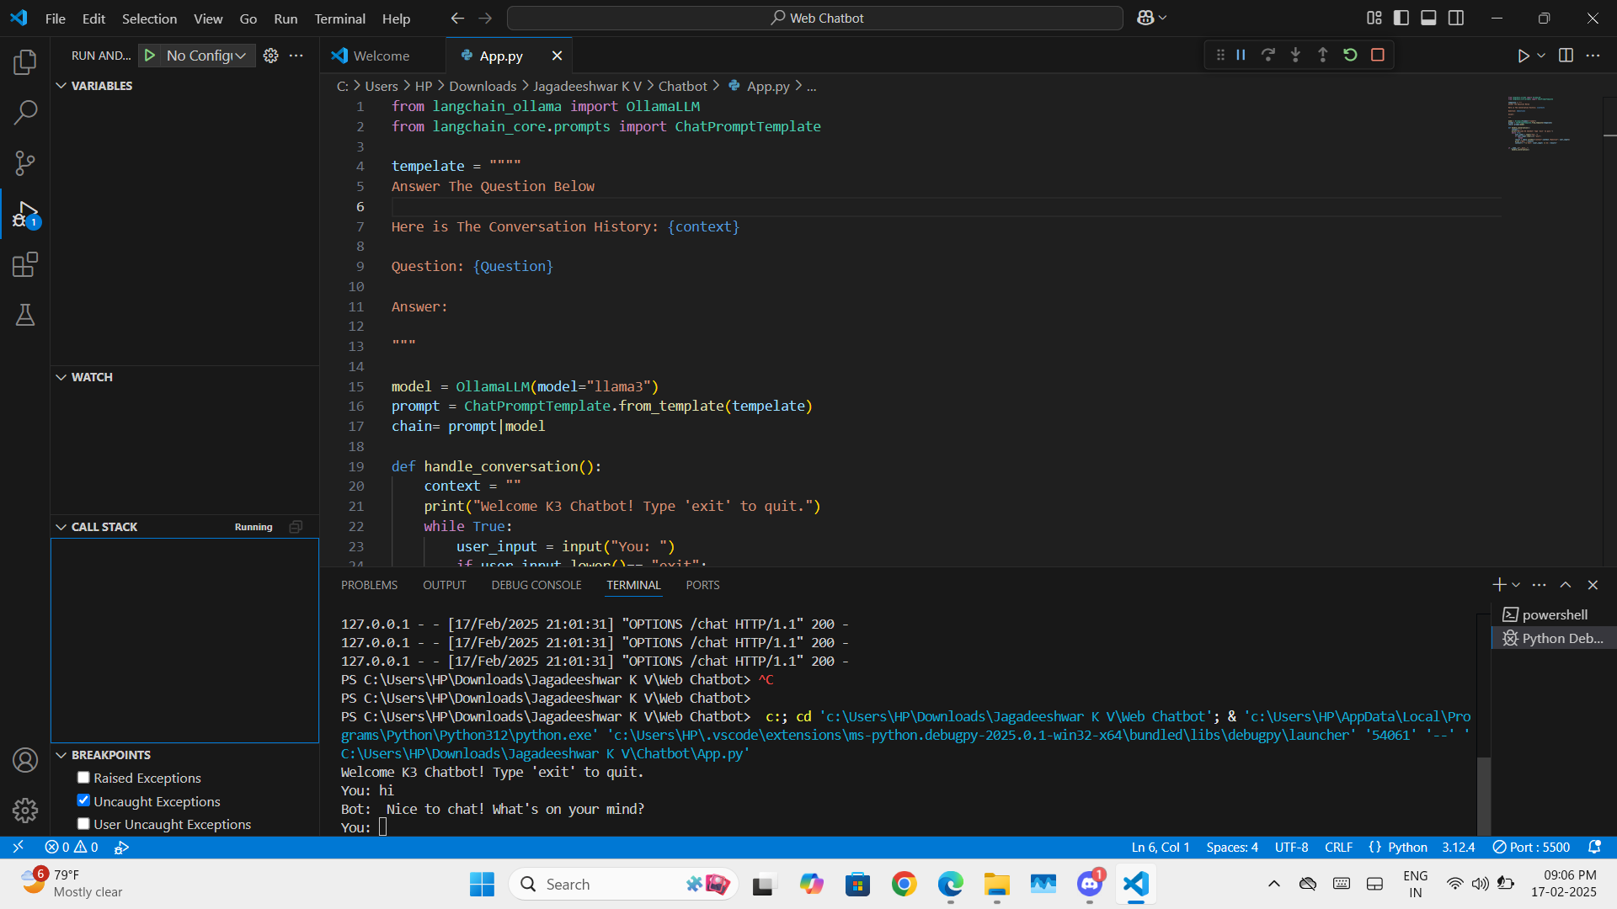
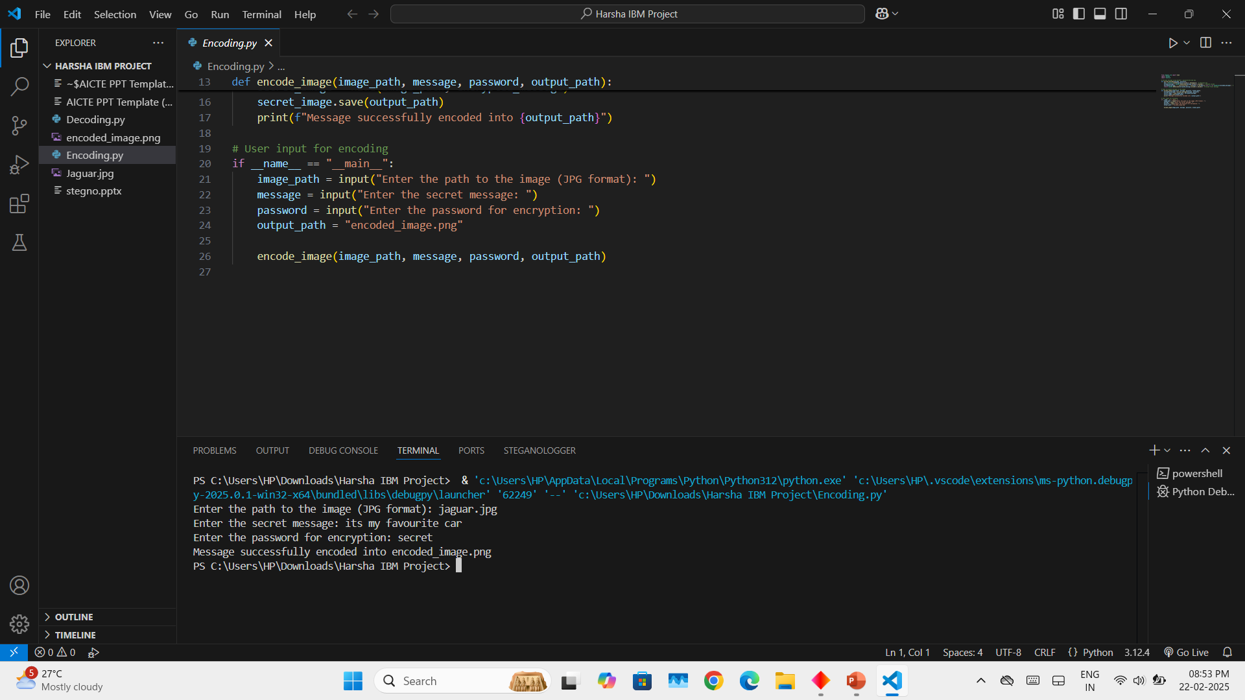
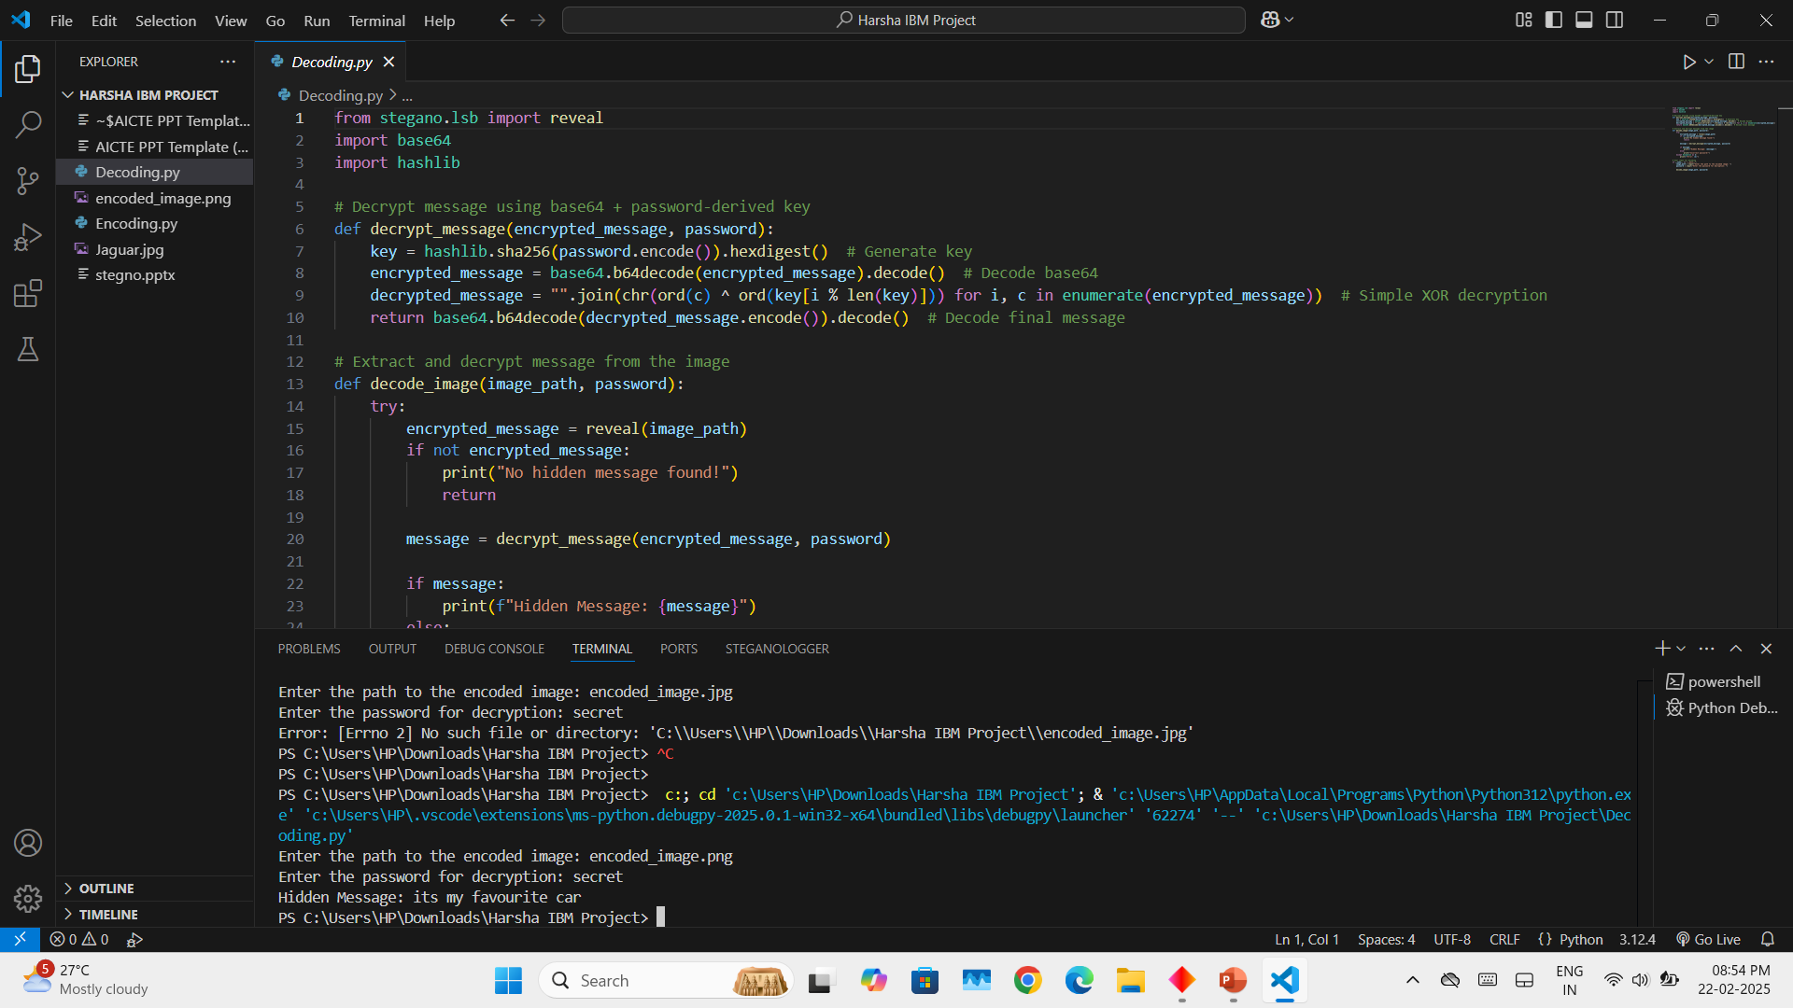
Results

Slide 8
Conclusion
Your Python-based password-protected steganography tool is a powerful, secure, and user-friendly solution for embedding hidden messages inside images. By combining steganography with encryption, it ensures that only users with the correct password can retrieve the secret information.
This tool stands out because of its double-layered security, ease of use, and cross-platform compatibility. It has practical applications for privacy-conscious users, Ethical Hackers, Corporate and Government Agencies.

Slide 9
GitHub Link
https://github.com/harsha-2-006/AICTE-steganography-Project.git

Slide 10
THANK YOU

